Slide 1
Lecture 3
Programming IT Course
GNU C
Making Decision and Looping
Instructor: Dr. Nguyen Ngoc Truong Minh
Vietnamese German University (VGU), 2014

Slide 2
Lecture Objectives
In this chapter, you will learn:
To develop algorithms through the process of top-down, stepwise refinement
To use the if selection statement and if...else selection statement to select actions
To use the while repetition statement to execute statements in a program repeatedly
Counter-controlled repetition and sentinel-controlled repetition
Structured programming
The increment, decrement and assignment operators

Slide 3
Lecture Objectives
Also in this chapter, you will learn:
The essentials of counter-controlled repetition
To use the for and do...while repetition statements to execute statements in a program repeatedly
To understand multiple selection using the switch selection statement
To use the break and continue program control statements to alter the flow of control
To use the logical operators to form complex conditional expressions in control statements
To avoid the consequences of confusing the equality and assignment operators

Slide 4
Lecture Contents
3.1 Introduction
3.2 Control Structures
3.3 The if Selection Statement
3.4 The if...else Selection Statement
3.5 The while Repetition Statement
Formulating Algorithms: Case Study 1 (Counter-Controlled Repetition)
Formulating Algorithms with Top-Down, Stepwise Refinement: Case Study 2 (Sentinel-Controlled Repetition)
Formulating Algorithms with Top-Down, Stepwise Refinement: Case Study 3 (Nested Control Structures)
3.6 Assignment Operators
3.7 Increment and Decrement Operators

Slide 5
Lecture Contents
3.8 Repetition Essentials
3.9 for Repetition Statement
3.10 for Statement: Notes and Observations
3.11 Examples Using the for Statement
3.12 switch Multiple-Selection Statement
3.13 do...while Repetition Statement
3.14 break and continue Statements
3.15 Logical Operators
3.16 Confusing Equality (==) and Assignment (=) Operators
3.17 Structured Programming Summary

Slide 6
3.1 Introduction
This lecture introduces …
Making decision/selection structures
if
if…else
Repetition control structures
for
while
do…while
switch multiple selection statement
break statement
Used for exiting immediately and rapidly from certain control structures
continue statement
Used for skipping the remainder of the body of a repetition structure and proceeding with the next iteration of the loop

Slide 7
3.2 Control Structures
Sequential execution
Statements executed one after the other in the order written
Transfer of control
When the next statement executed is not the next one in sequence
Overuse of goto statements led to many problems
Bohm and Jacopini
All programs written in terms of 3 control structures
Sequence structures: Built into C. Programs executed sequentially by default
Selection structures: C has three types: if, if…else, and switch
Repetition structures: C has three types: while, do…while and for

Slide 8
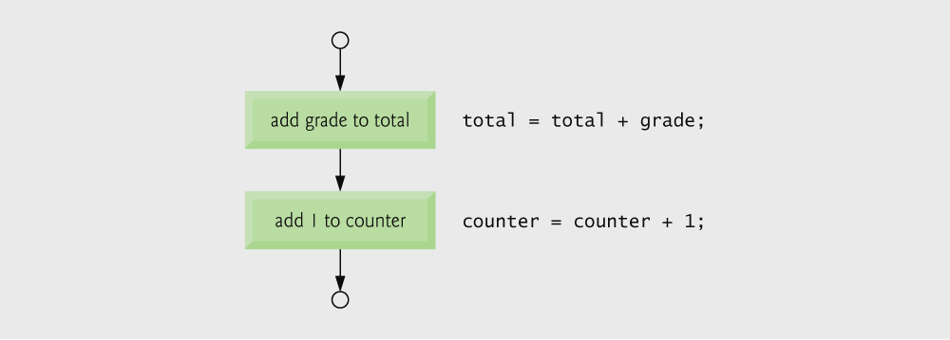
Fig. 3.1 | Flowcharting C’s sequence structure.

Slide 9
Flowchart
Graphical representation of an algorithm
Drawn using certain special-purpose symbols connected by arrows called flowlines
Rectangle symbol (action symbol):
Indicates any type of action
Oval symbol (declaration symbol):
Indicates the beginning or end of a program or a section of code
Single-entry/single-exit control structures
Connect exit point of one control structure to entry point of the next (control-structure stacking)
Makes programs easy to build

Slide 10
3.3 The if selection statement
Selection structure
Used to choose among alternative courses of action
Pseudocode:
If student’s grade is greater than or equal to 60 Print “Passed”
If condition true
print statement executed and program goes on to next statement
If false, print statement is ignored and the program goes onto the next statement
Indenting makes programs easier to read
C ignores whitespace characters

Slide 11
Good Programming Practice 3.1
Consistently applying responsible indentation conventions greatly improves program readability. We suggest a fixed-size tab of about 1/4 inch or three blanks per indent.
Pseudocode is often used to “think out” a program during the program design process. Then, the pseudocode program is converted to C.

Slide 12
Pseudocode statement in C:
if ( grade >= 60 ) printf( "Passed\n" );
C code corresponds closely to the pseudocode
Diamond symbol (decision symbol)
Indicates decision is to be made
Contains an expression that can be true or false
Test the condition, follow appropriate path

Slide 13

Fig. 3.2 | Flowcharting the single-selection if statement.

Slide 14
3.4 The if…else selection statement
if
Only performs an action if the condition is true
if…else
Specifies an action to be performed both when the condition is true and when it is false
Pseudocode:
If student’s grade is greater than or equal to 60 Print “Passed”
else Print “Failed”
Note spacing/indentation conventions

Slide 15
Good Programming Practice 3.2
Indent both body statements of an if...else statement.
If there are several levels of indentation, each level should be indented the same additional amount of space.

Slide 16
C code:
if ( grade >= 60 )
printf( "Passed\n");
else
printf( "Failed\n");
Ternary conditional operator (?:)
Takes three arguments (condition, value if true, value if false)
Our pseudocode could be written:
printf( "%s\n", grade >= 60 ? "Passed" : "Failed" );
Or it could have been written:
grade >= 60 ? printf( “Passed\n” ) : printf( “Failed\n” );

Slide 17
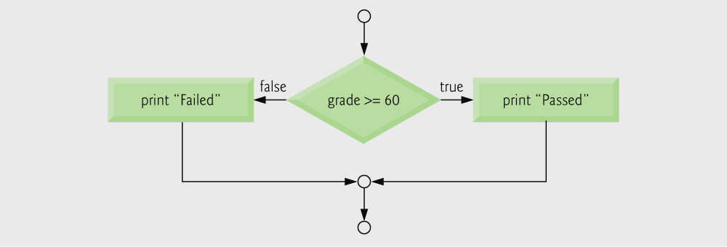
Fig. 3.3 | Flowcharting the double-selection if...else statement.

Slide 18
Nested if…else statements
Test for multiple cases by placing if…else selection statements inside if…else selection statement
Once condition is met, rest of statements skipped
Deep indentation usually not used in practice

Slide 19
Pseudocode for a nested if…else statement
If student’s grade is greater than or equal to 90 Print “A” else If student’s grade is greater than or equal to 80 Print “B” else If student’s grade is greater than or equal to 70 Print “C” else If student’s grade is greater than or equal to 60 Print “D” else Print “F”

Slide 20
Compound statement:
Set of statements within a pair of braces
Example:
if ( grade >= 60 )
printf( "Passed.\n" );
else {
printf( "Failed.\n" );
printf( "You must take this course again.\n" );
}
Without the braces, the statement
printf( "You must take this course again.\n" );
would be executed automatically

Slide 21
Software Engineering Observation 3.1
A compound statement can be placed anywhere in a program that a single statement can be placed.

Slide 22
Common Programming Error 3.1
Forgetting one or both of the braces that delimit a compound statement.

Slide 23
Block
Compound statements with declarations
Syntax errors
Caught by compiler
Logic errors
Have their effect at execution time
Non-fatal: program runs, but has incorrect output
Fatal: program exits prematurely

Slide 24
Common Programming Error 3.2
Placing a semicolon after the condition in an if statement as in if ( grade >= 60 ); leads to a logic error in single-selection if statements and a syntax error in double-selection if statements.

Slide 25
Error-Prevention Tip 3.1
Typing the beginning and ending braces of compound statements before typing the individual statements within the braces helps avoid omitting one or both of the braces, preventing syntax errors and logic errors (where both braces are indeed required).

Slide 26
Software Engineering Observation 3.2
Just as a compound statement can be placed anywhere a single statement can be placed, it is also possible to have no statement at all, i.e., the empty statement. The empty statement is represented by placing a semicolon (;) where a statement would normally be.

Slide 27
3.5 The while repetition statement
Repetition structure
Programmer specifies an action to be repeated while some condition remains true
Pseudocode:
While there are more items on my shopping list Purchase next item and cross it off my list
while loop repeated until condition becomes false
Example:
int product = 2;
while ( product <= 1000 ) product = 2 * product;

Slide 28
Common Programming Error 3.3
Not providing the body of a while statement with an action that eventually causes the condition in the while to become false. Normally, such a repetition structure will never terminate — an error called an “infinite loop”.

Slide 29
Common Programming Error 3.4
Spelling the keyword while with an uppercase W as in While (remember that C is a case-sensitive language). All of C’s reserved keywords such as while, if and else contain only lowercase letters.

Slide 30
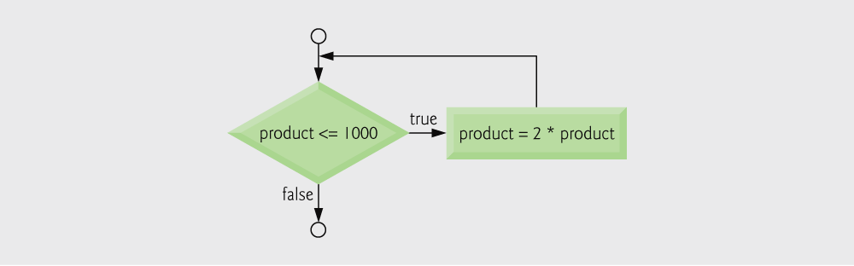
Fig. 3.4 | Flowcharting the while repetition statement.

Slide 31
3.5.1 Counter-Controlled Repetition
Counter-controlled repetition
Loop repeated until counter reaches a certain value
Definite repetition: number of repetitions is known
Example: A class of ten students took a quiz. The grades (integers in the range 0 to 100) for this quiz are available to you. Determine the class average on the quiz.

Slide 32
Fig. 3.5 | Pseudocode algorithm that uses counter-controlled repetition to solve the class average problem.

Slide 33
Outline
Counter to control while loop
Initialize counter to 1
while loop iterates as long as counter <= 10
Increment the counter

Slide 34
Outline
Calculate the average

Slide 35
Common Programming Error 3.5
If a counter or total is not initialized, the results of your program will probably be incorrect. This is an example of a logic error.

Slide 36
Error-Prevention Tip 3.2
Initialize all counters and totals.

Slide 37
3.5.2 Sentinel-Control Repetition
Problem becomes:
Develop a class-averaging program that will process an arbitrary number of grades each time the program is run.
Unknown number of students
How will the program know to end?
Use sentinel value
Also called signal value, dummy value, or flag value
Indicates “end of data entry”
Loop ends when user inputs the sentinel value
Sentinel value chosen so it cannot be confused with a regular input (such as -1 in this case)

Slide 38
Common Programming Error 3.6
Choosing a sentinel value that is also a legitimate data value.

Slide 39
Top-down, stepwise refinement
Begin with a pseudocode representation of the top:
Determine the class average for the quiz
Divide top into smaller tasks and list them in order:
Initialize variables Input, sum and count the quiz grades Calculate and print the class average
Many programs have three phases:
Initialization: initializes the program variables
Processing: inputs data values and adjusts program variables accordingly
Termination: calculates and prints the final results

Slide 40
Software Engineering Observation 3.3
Each refinement, as well as the top itself, is a complete specification of the algorithm; only the level of detail varies.

Slide 41
Refine the initialization phase from Initialize variables to:
Initialize total to zero Initialize counter to zero
Refine Input, sum and count the quiz grades to
Input the first grade (possibly the sentinel) While the user has not as yet entered the sentinel Add this grade into the running total Add one to the grade counter Input the next grade (possibly the sentinel)
Refine Calculate and print the class average to
If the counter is not equal to zero Set the average to the total divided by the counter Print the average else Print “No grades were entered”

Slide 42
Common Programming Error 3.7
An attempt to divide by zero causes a fatal error.

Slide 43
Fig. 3.6 | Pseudocode algorithm that uses sentinel-controlled repetition to solve the class average problem.

Slide 44
Good Programming Practice 3.3
When performing division by an expression whose value could be zero, explicitly test for this case and handle it appropriately in your program (such as printing an error message) rather than allowing the fatal error to occur.

Slide 45
Software Engineering Observation 3.4
Many programs can be divided logically into three phases: an initialization phase that initializes the program variables; a processing phase that inputs data values and adjusts program variables accordingly; and a termination phase that calculates and prints the final results.

Slide 46
Software Engineering Observation 3.5
You terminate the top-down, stepwise refinement process when the pseudocode algorithm is specified in sufficient detail for you to be able to convert the pseudocode to C.
Implementing the C program is then normally straightforward.

Slide 47
Outline
float type indicates variable can be a non-integer

Slide 48
Outline
while loop repeats until user enters a value of -1
Ensures the user entered at least one grade
Converts total to float type
Prints result with 2 digits after decimal point

Slide 49
Outline

Slide 50
Good Programming Practice 3.4
In a sentinel-controlled loop, the prompts requesting data entry should explicitly remind the user what the sentinel value is.

Slide 51
Common Programming Error 3.8
Using precision in a conversion specification in the format control string of a scanf statement is wrong. Precisions are used only in printf conversion specifications.

Slide 52
Common Programming Error 3.9
Using floating-point numbers in a manner that assumes they are represented precisely can lead to incorrect results. Floating-point numbers are represented only approximately by most computers.

Slide 53
Error-Prevention Tip 3.3
Do not compare floating-point values for equality.

Slide 54
3.5.3 Nested Control Structures
Problem
A college has a list of test results (1=pass, 2=fail) for 10 students
Write a program that analyzes the results
If more than 8 students pass, print "Raise Tuition"
Notice that
The program must process 10 test results
Counter-controlled loop will be used
Two counters can be used
One for number of passes, one for number of fails
Each test result is a number — either a 1 or a 2
If the number is not a 1, we assume that it is a 2

Slide 55
Top level outline
Analyze exam results and decide if tuition should be raised
First Refinement
Initialize variables
Input the ten quiz grades and count passes and failures
Print a summary of the exam results and decide if tuition should be raised
Refine Initialize variables to
Initialize passes to zero
Initialize failures to zero
Initialize student counter to one

Slide 56
Refine Input the ten quiz grades and count passes and failures to
While student counter is less than or equal to ten Input the next exam result
If the student passed
Add one to passes else Add one to failures
Add one to student counter
Refine Print a summary of the exam results and decide if tuition should be raised to
Print the number of passes
Print the number of failures
If more than eight students passed Print “Raise tuition”

Slide 57
Fig. 3.8 | Pseudocode for examination results problem.

Slide 58
Outline
while loop continues until 10 students have been processed
if and else statements are nested inside while loop

Slide 59
Outline

Slide 60
Outline

Slide 61
Performance Tip 3.1
Initializing variables when they are defined can help reduce a program’s execution time.

Slide 62
Performance Tip 3.2
Many of the performance tips we mention in this text result in nominal improvements, so the reader may be tempted to ignore them. Note that the cumulative effect of all these performance enhancements can make a program perform significantly faster. Also, significant improvement is realized when a supposedly nominal improvement is placed in a loop that may repeat a large number of times.

Slide 63
Software Engineering Observation 3.6
Experience has shown that the most difficult part of solving a problem on a computer is developing the algorithm for the solution. Once a correct algorithm has been specified, the process of producing a working C program is normally straightforward.

Slide 64
Software Engineering Observation 3.7
Many programmers write programs without ever using program development tools such as pseudocode. They feel that their ultimate goal is to solve the problem on a computer and that writing pseudocode merely delays the production of final outputs.

Slide 65
3.6 Assignment Operators
Assignment operators abbreviate assignment expressions
c = c + 3;
can be abbreviated as c += 3; using the addition assignment operator
Statements of the form
variable = variable operator expression;
can be rewritten as
variable operator= expression;
Examples of other assignment operators:
d -= 4 (d = d - 4)
e *= 5 (e = e * 5)
f /= 3 (f = f / 3)
g %= 9 (g = g % 9)

Slide 66
Fig. 3.9 | Arithmetic assignment operators.

Slide 67
3.7 Increment and Decrement Operators
Increment operator (++)
Can be used instead of c+=1
Decrement operator (--)
Can be used instead of c-=1
Preincrement
Operator is used before the variable (++c or --c)
Variable is changed before the expression, it is in, is evaluated
Postincrement
Operator is used after the variable (c++ or c--)
Expression executes before the variable is changed

Slide 68
If c equals 5, then
printf( "%d", ++c );
Prints 6
printf( "%d", c++ );
Prints 5
In either case, c now has the value of 6
When variable not in an expression
Preincrementing and postincrementing have the same effect
++c;
printf( “%d”, c );
Has the same effect as
c++;
printf( “%d”, c );

Slide 69
Fig. 3.10 | Increment and decrement operators.

Slide 70
Outline
c is printed, then incremented
c is incremented, then printed

Slide 71
Good Programming Practice 3.5
Unary operators should be placed directly next to their operands with no intervening spaces.

Slide 72
Common Programming Error 3.10
Attempting to use the increment or decrement operator on an expression other than a simple variable name is a syntax error, e.g., writing ++(x + 1).

Slide 73
Error-Prevention Tip 3.4
C generally does not specify the order in which an operator’s operands will be evaluated.
Therefore, you should avoid using statements with increment or decrement operators in which a particular variable being incremented or decremented appears more than once.

Slide 74
Fig. 3.11 | Precedence of the operators encountered so far in the text.

Slide 75
3.8 Repetition Essentials
Loop
Group of instructions computer executes repeatedly while some condition remains true
Counter-controlled repetition
Definite repetition: know how many times loop will execute
Control variable used to count repetitions
Sentinel-controlled repetition
Indefinite repetition
Used when number of repetitions not known
Sentinel value indicates "end of data"

Slide 76
3.8.1 Counter-Controlled Repetition
Counter-controlled repetition requires
The name of a control variable (or loop counter)
The initial value of the control variable
An increment (or decrement) by which the control variable is modified each time through the loop
A condition that tests for the final value of the control variable (i.e., whether looping should continue)

Slide 77
Example:
int counter = 1; // initialization
while (counter <= 10) { // repetition condition
printf("%d \n", counter); // display counter
++counter; // increment
}
The statement
int counter = 1;
Names counter variable
Defines it to be an integer
Reserves space for it in memory
Sets it to an initial value of 1

Slide 78
Outline
Definition and assignment are performed simultaneously

Slide 79
Condensed code
C Programmers would make the program more concise
Initialize counter to 0
while ( ++counter <= 10 ) printf(“%d \n”, counter);

Slide 80
Common Programming Error 3.11
Because floating-point values may be approximate, controlling counting loops with floating-point variables may result in imprecise counter values and inaccurate tests for termination.

Slide 81
Error-Prevention Tip 3.6
Control counting loops with integer values.

Slide 82
Good Programming Practice 3.6
Indent the statements in the body of each control statement.

Slide 83
Good Programming Practice 3.7
Put a blank line before and after each control statement to make it stand out in a program.

Slide 84
Good Programming Practice 3.8
Too many levels of nesting can make a program difficult to understand. As a general rule, try to avoid using more than three levels of nesting.

Slide 85
Good Programming Practice 3.9
The combination of vertical spacing before and after control statements and indentation of the bodies of control statements within the control-statement headers gives programs a two-dimensional appearance that greatly improves program readability.

Slide 86
3.9 for Repetition Statement
Format when using for loops
for (initialization; loop continuation test; increment)
statement
Example:
for (int counter = 1; counter <= 10; counter++)
printf( "%d\n", counter );
Prints the integers from one to ten

Slide 87
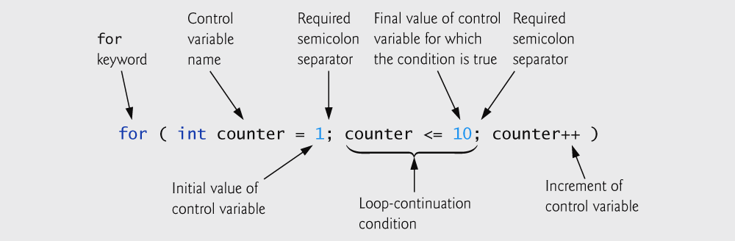
Fig. 3.12 for statement header components.

Slide 88
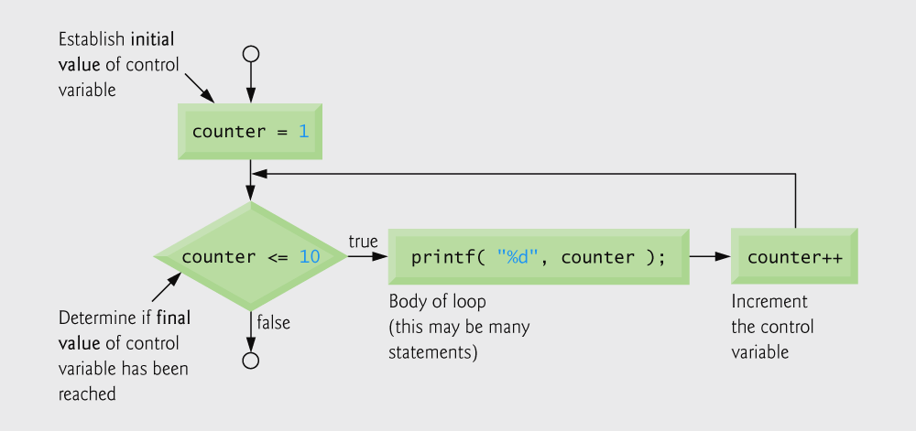
Fig. 3.13 Flowcharting a typical for repetition statement.

Slide 89
for loops can usually be rewritten as while loops:
initialization; while ( loop continuation test ) { statement; increment; }
Initialization and increment:
Can be comma-separated lists
Example:
for (int i = 0, j = 0; j + i <= 10; j++, i++)
printf( "%d\n", j + i );

Slide 90
Outline
for loop begins by setting counter to 1 and repeats while counter <= 10. Each time the end of the loop is reached, counter is incremented by 1.

Slide 91
Software Engineering Observation 3.8
Place only expressions involving the control variables in the initialization and increment sections of a for statement. Manipulations of other variables should appear either before the loop (if they execute only once, like initialization statements) or in the loop body (if they execute once per repetition, like incrementing or decrementing statements).

Slide 92
Common Programming Error 3.11
Using an incorrect relational operator or using an incorrect initial or final value of a loop counter in the condition of a while or for statement can cause off-by-one errors.

Slide 93
Error-Prevention Tip 3.7
Using the final value in the condition of a while or for statement and using the <= relational operator will help avoid off-by-one errors. For a loop used to print the values 1 to 10, for example, the loop-continuation condition should be counter <= 10 rather than counter < 11 or counter < 10.

Slide 94
Common Programming Error 3.12
Using commas instead of semicolons in a for header is a syntax error.

Slide 95
Common Programming Error 3.13
Placing a semicolon immediately to the right of a for header makes the body of that for statement an empty statement. This is normally a logic error.

Slide 96
3.10 for Statement : Notes and Observations
Arithmetic expressions
Initialization, loop-continuation, and increment can contain arithmetic expressions.
For example, if x equals 2 and y equals 10
for ( j = x; j <= 4*x*y; j += y/x )
is equivalent to
for ( j = 2; j <= 80; j += 5 )
Notes about the for statement:
"Increment" may be negative (decrement)
If the loop continuation condition is initially false
The body of the for statement is not performed
Control proceeds with the next statement after the for statement
Control variable
Often printed or used inside for body, but not necessary

Slide 97
Error-Prevention Tip 3.8
Although the value of the control variable can be changed in the body of a for loop, this can lead to subtle errors. It is best not to change it.

Slide 98
3.11 Examples Using the for Statement
Outline
Note that number has a different value each time this statement is executed

Slide 99
Good Programming Practice 3.8
Although statements preceding a for and statements in the body of a for can often be merged into the for header, but avoid doing so because it makes the program more difficult to read.

Slide 100
Good Programming Practice 3.9
Limit the size of control-statement headers to a single line if possible.

Slide 101
Outline
additional header math.h
pow function calculates the value of the first argument raised to the power of the second argument

Slide 102
Outline

Slide 103
Error-Prevention Tip 3.9
Do not use variables of type float or double to perform monetary calculations. The impreciseness of floating-point numbers can cause errors that will result in incorrect monetary values.

Slide 104
3.12 switch Multiple-Selection Statement
switch
Useful when a variable or expression is tested for all the values it can assume and different actions are taken
Format
Series of case labels and an optional default case
switch ( value ){
case '1':
actions in case 1
case '2':
actions in case 2
default:
actions in default
}
break; exits from statement

Slide 105
Outline
EOF stands for “end of file;” this character varies from system to system
switch statement checks each of its nested cases for a match
break statement makes program skip to end of switch

Slide 106
Outline

Slide 107
Outline
default case occurs if none of the cases are matched

Slide 108
Outline
EOF stands for “end of file;” this character varies from system to system

Slide 109
Portability Tip 3.1
The keystroke combinations for entering EOF (end of file) are system dependent.

Slide 110
Portability Tip 3.2
Testing for the symbolic constant EOF rather than –1 makes programs more portable. The C standard states that EOF is a negative integral value (but not necessarily –1). Thus, EOF could have different values on different systems.

Slide 111
Common Programming Error 3.12
Forgetting a break statement when one is needed in a switch statement is a logic error.

Slide 112
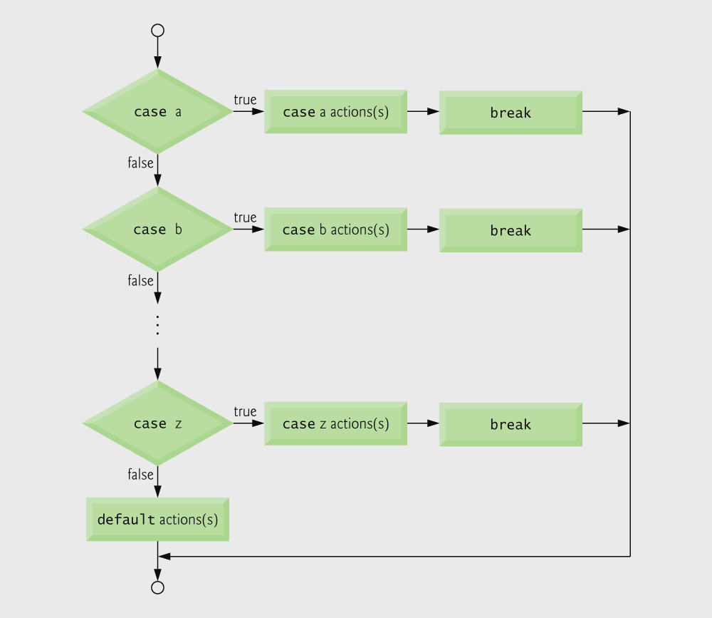
Fig. 3.14 switch multiple-selection statement with breaks

Slide 113
Good Programming Practice 3.10
Provide a default case in switch statements. Cases not explicitly tested in a switch are ignored. The default case helps prevent this by focusing the programmer on the need to process exceptional conditions. There are situations in which no default processing is needed.

Slide 114
Good Programming Practice 3.11
Although the case clauses and the default case clause in a switch statement can occur in any order, it is considered good programming practice to place the default clause last.

Slide 115
Good Programming Practice 3.12
In a switch statement when the default clause is listed last, the break statement is not required. But some programmers include this break for clarity and symmetry with other cases.

Slide 116
Common Programming Error 3.13
Not processing newline characters in the input when reading characters one at a time can cause logic errors.

Slide 117
Error-Prevention Tip 3.10
Remember to provide processing capabilities for newline (and possibly other white-space) characters in the input when processing characters one at a time.

Slide 118
3.13 do…while Repetition Statement
The do…while repetition statement
Similar to the while structure
Condition for repetition only tested after the body of the loop is performed
All actions are performed at least once
Format:
do {
statement;
} while ( condition );

Slide 119
Example (letting counter = 1):
do {
printf( "%d", counter );
} while (++counter <= 10);
Prints the integers from 1 to 10

Slide 120
Good Programming Practice 3.13
Some programmers always include braces in a do...while statement even if the braces are not necessary. This helps eliminate ambiguity between the do...while statement containing one statement and the while statement.

Slide 121
Common Programming Error 3.14
Infinite loops are caused when the loop-continuation condition in a while, for or do...while statement never becomes false. To prevent this, make sure there is not a semicolon immediately after the header of a while or for statement. In a counter-controlled loop, make sure the control variable is incremented (or decremented) in the loop. In a sentinel-controlled loop, make sure the sentinel value is eventually input.

Slide 122
Outline
increments counter then checks if it is less than or equal to 10

Slide 123
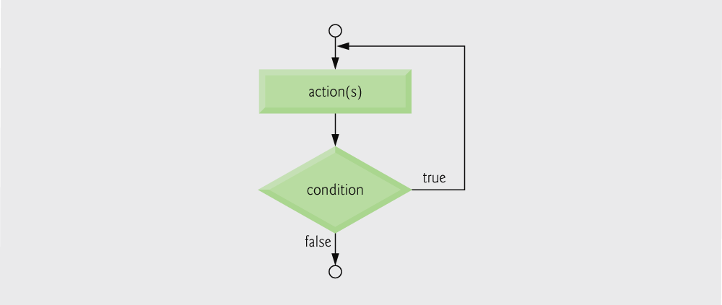
Fig. 3.15 | Flowcharting the do...while repetition statement.

Slide 124
3.14 break and continue Statements
break
Causes immediate exit from a while, for, do…while or switch statement
Program execution continues with the first statement after the structure
Common uses of the break statement
Escape early from a loop
Skip the remainder of a switch statement

Slide 125
Outline
break immediately ends for loop

Slide 126
continue
Skips the remaining statements in the body of a while, for or do…while statement
Proceeds with the next iteration of the loop
while and do…while
Loop-continuation test is evaluated immediately after the continue statement is executed
for
Increment expression is executed, then the loop-continuation test is evaluated

Slide 127
Outline
continue skips to end of for loop and performs next iteration

Slide 128
Software Engineering Observation 3.9
Some programmers feel that break and continue violate the norms of structured programming. Because the effects of these statements can be achieved by structured programming techniques we will soon learn, these programmers do not use break and continue.

Slide 129
Performance Tip 3.2
The break and continue statements, when used properly, perform faster than the corresponding structured techniques that we will soon learn.

Slide 130
Software Engineering Observation 3.10
There is a tension between achieving quality software engineering and achieving the best-performing software. Often one of these goals is achieved at the expense of the other.

Slide 131
3.15 Logical Operators
&& ( logical AND )
Returns true if both conditions are true
|| ( logical OR )
Returns true if either of its conditions are true
! ( logical NOT, logical negation )
Reverses the truth/falsity of its condition
Unary operator has one operand
Useful as conditions in loops
Expression Result
true && false false
true || false true
!false true

Slide 132
Fig. 3.16 | Truth table for the && (logical AND) operator.

Slide 133
Fig. 3.17 | Truth table for the logical OR (||) operator.

Slide 134
Fig. 3.18 | Truth table for operator ! (logical negation).

Slide 135
Performance Tip 3.3
In expressions using operator &&, make the condition that is most likely to be false the leftmost condition.
In expressions using operator ||, make the condition that is most likely to be true the leftmost condition.
This can reduce a program’s execution time.

Slide 136
Fig. 3.19 | Operator precedence and associability.

Slide 137
3.16 Confusing Equality (==) and Assignment (=) Operators
Dangerous error
Does not ordinarily cause syntax errors
Any expression that produces a value can be used in control structures
Nonzero values are true, zero values are false
Example using ==:
if ( payCode == 4 )
printf( "You get a bonus!\n" );
Checks payCode, if it is 4 then a bonus is awarded

Slide 138
Example, replacing == with =:
if ( payCode = 4 )
printf( "You get a bonus!\n" );
This sets payCode to 4
4 is nonzero, so expression is true, and bonus awarded no matter what the payCode was
Logic error, not a syntax error

Slide 139
Common Programming Error 3.15
Using operator == for assignment or using operator = for equality is a logic error.

Slide 140
lvalues
Expressions that can appear on the left side of an equation
Their values can be changed, such as variable names
x = 4;
rvalues
Expressions that can only appear on the right side of an equation
Constants, such as numbers
Cannot write 4 = x;
Must write x = 4;
lvalues can be used as rvalues, but not vice versa
y = x;

Slide 141
Good Programming Practice 3.14
When an equality expression has a variable and a constant, as in x==1, some programmers prefer to write the expression with the constant on the left and the variable name on the right (e.g. 1==x) as protection against the logic error that occurs when you accidentally replace operator == with =.

Slide 142
Error-Prevention Tip 3.11
After you write a program, text search it for every = and check that it is being used properly.

Slide 143
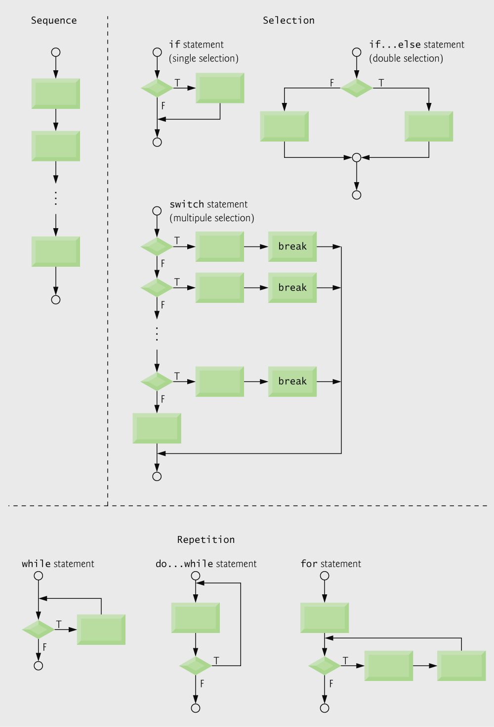
Fig. 3.20 | C’s single-entry/single-exit sequence, selection and repetition statements.

Slide 144
3.17 Structured Programming Summary
Structured programming
Easier than unstructured programs to understand, test, debug and, modify programs
Fig. 3.21 | Rules for forming structured programs.

Slide 145

Fig. 3.22 | Simplest flowchart.

Slide 146
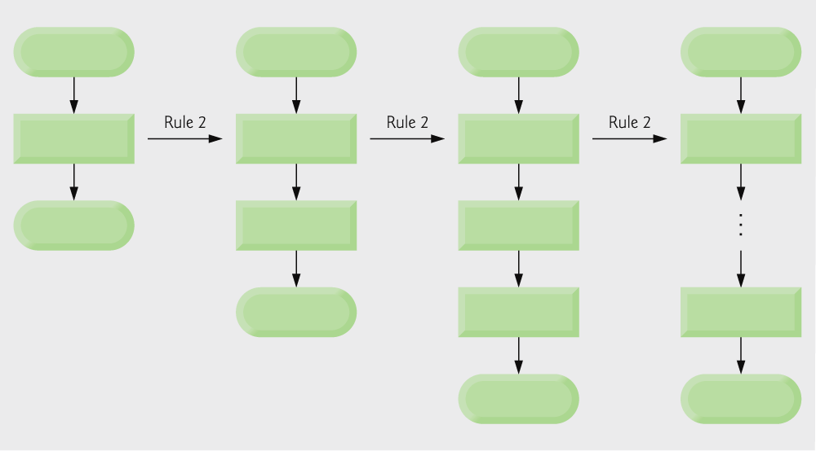
Fig. 3.23 | Repeatedly applying rule 2 of Fig. 3.21 to the simplest flowchart.

Slide 147
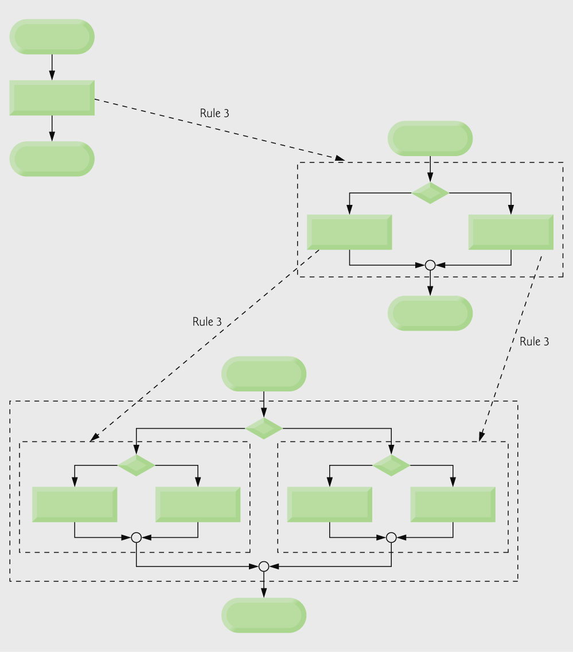
Fig. 3.24 | Applying rule 3 of Fig. 3.21 to the simplest flowchart.

Slide 148
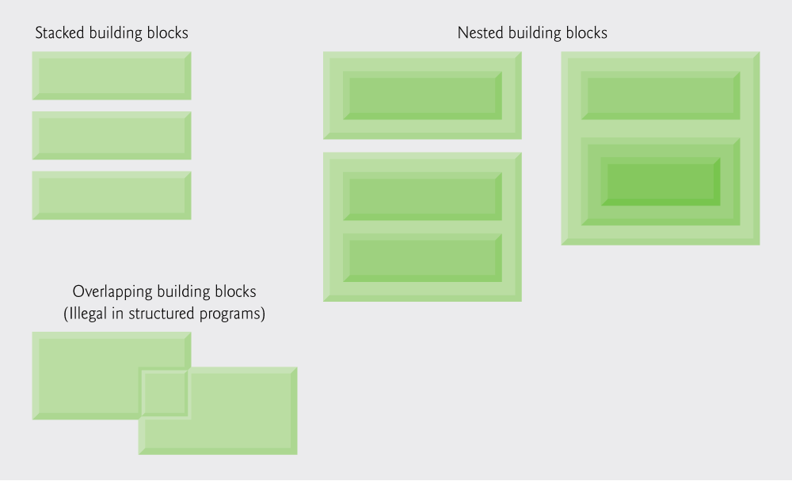
Fig. 3.25 | Stacked, nested and overlapped building blocks.

Slide 149
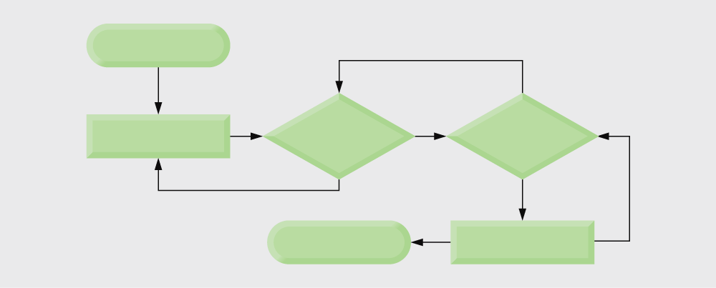
Fig. 3.26 | An unstructured flowchart.

Slide 150
All programs can be broken down into 3 controls
Sequence – handled automatically by compiler
Selection – if, if…else or switch
Repetition – while, do…while or for
Can only be combined in two ways
Nesting (rule 3)
Stacking (rule 2)
Any selection can be rewritten as an if statement, and any repetition can be rewritten as a while statement

Slide 151
Exercises
Write a C Program to Check if a given Integer is Odd or Even
Write a C Program to Find the Biggest of 3 given Numbers
Write a C Program to Reverse a Number & Check if it is a Palindrome
Write a C Program to Convert a Given Number of Days in terms of Years, Weeks & Days

Slide 152
Exercises
Write a C code that finds the zero of a function y=ax+b (e.g. x such as y=0) without solving the equation. The zero will be found within a precision limit eps=10⁻³. You will start from a fixed point at x=0 and move x in the proper direction until abs(y) < eps.
Write a C Program to Convert Numbers to Roman Numerals
Write a C Program to Convert the given Binary Number into Decimal

Slide 153
Exercises
Read a positive integer value, and compute the following sequence: If the number is even, halve it; if it's odd, multiply by 3 and add 1. Repeat this process until the value is 1, printing out each value. Finally print out how many of these operations you performed.
Typical output might be:
Initial value is 9
Next value is 28
Next value is 14
Next value is 7
Next value is 22
Next value is 11
Next value is 34
Next value is 17
Next value is 52
Next value is 26
Next value is 13
Next value is 40
Next value is 20
Next value is 10
Next value is 5
Next value is 16
Next value is 8
Next value is 4
Next value is 2
Final value 1, number of steps 19
If the input value is less than 1, print a message containing the word Error
and perform an exit(0);

Slide 154
Questions ?

